Slide 1

Little Home Artists
Coloring Book

Slide 2


Trace & Color
My Home
House

Slide 3


Trace & Color
My Home
Garden

Slide 4
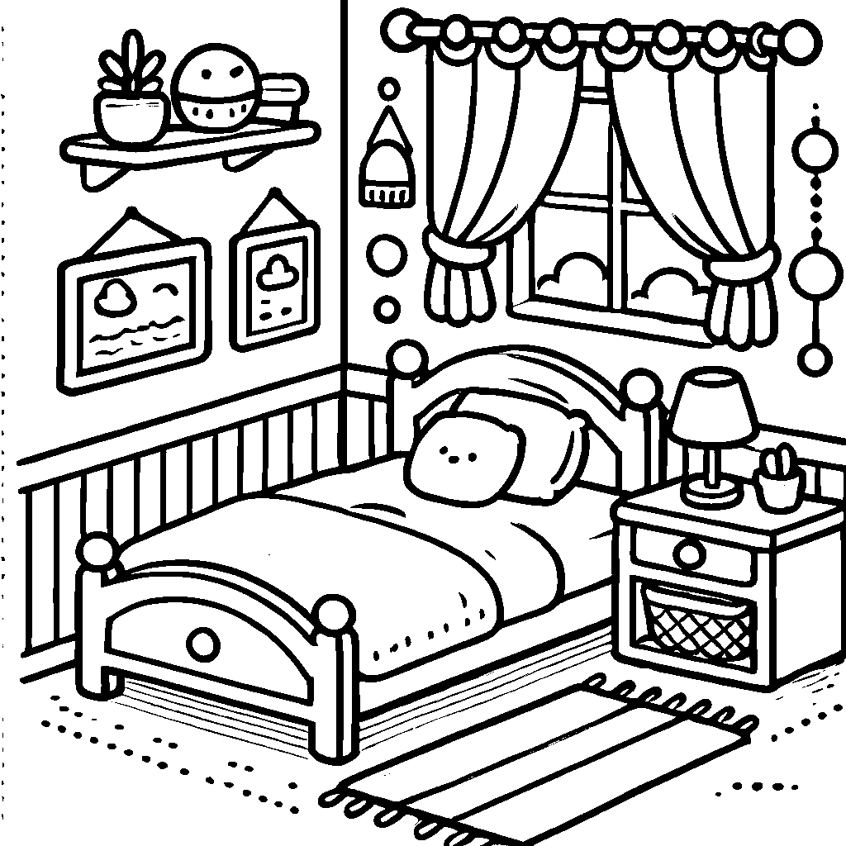
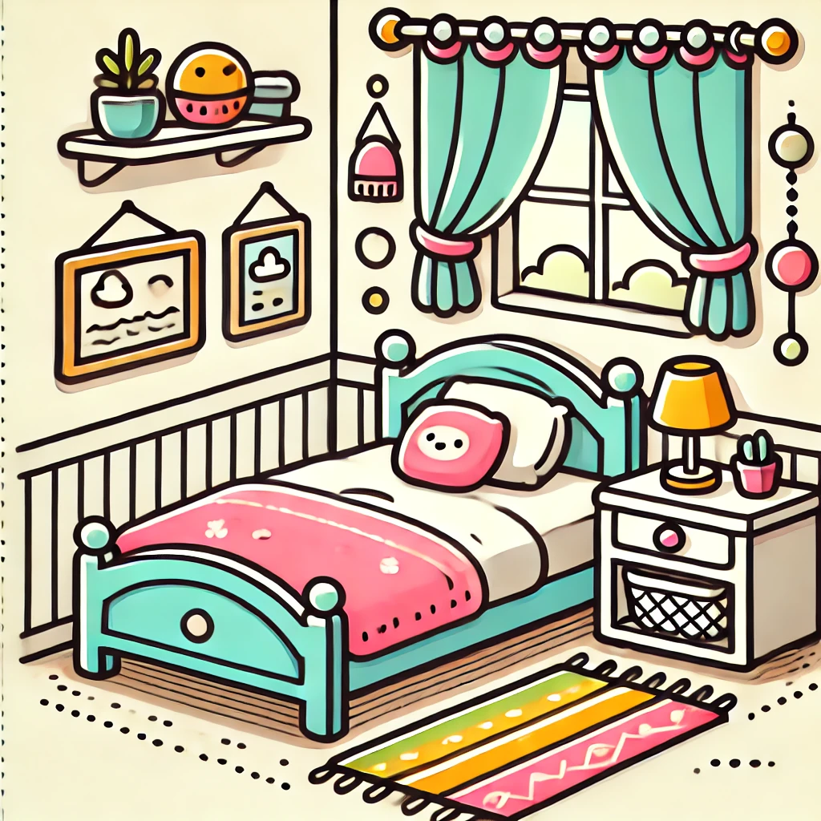
Trace & Color
My Home
Bedroom

Slide 5


Trace & Color
My Home
Living room

Slide 6


Trace & Color
My Home
Bathroom

Slide 7


Trace & Color
My Home
Kitchen

Slide 8
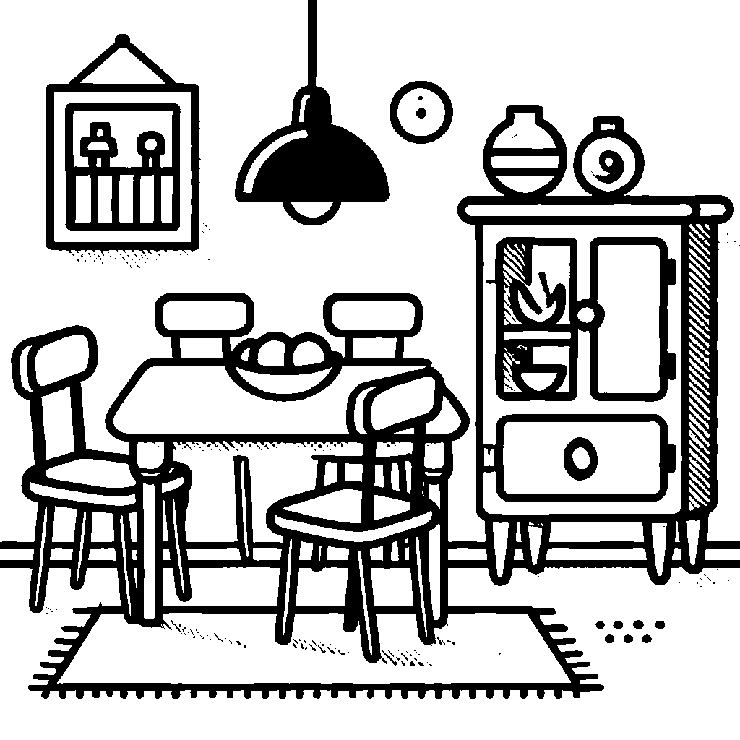
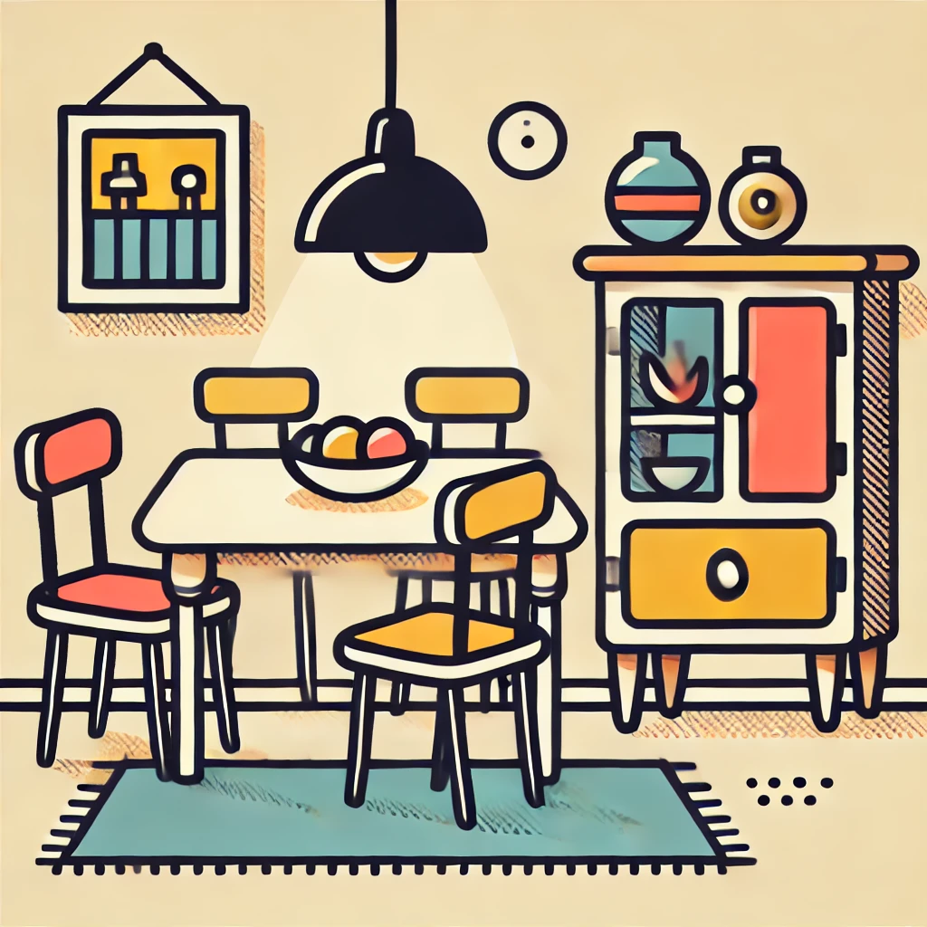
Trace & Color
My Home
Dining room

Slide 9


Trace & Color
My Home
Balcony

Slide 10

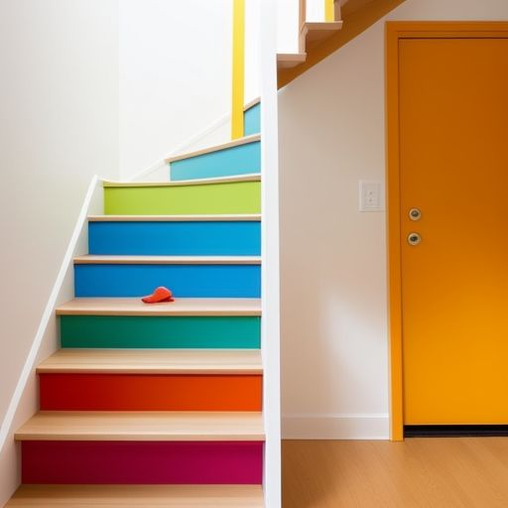



Trace & Color
My Home
Stairs

Slide 11


Trace & Color
My Home
Door

Slide 12


Trace & Color
My Home
Window

